Slide 1
L2. Fundamentals of Bayesian Statistics

Slide 2

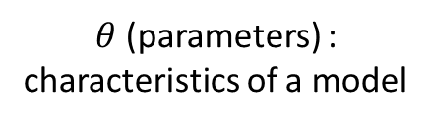

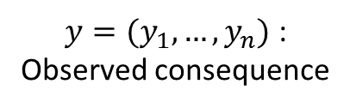
Statistics
What is an probability of getting head?
Statistics infer the causes that generated the observed data.
Model
data
$θ$ (parameters) :
characteristics of a model
$y=(y_{1},…,y_{n})$ :
Observed consequence
$θ$ : Probability of having a head for each coin tossing
$$(Head, Head, Tail,…)$$

Slide 3
View on Probability
Frequentists :
probability only has meaning in terms of a limiting case of repeated measurements
probabilities are fundamentally related to frequencies of events.
Bayesian :
degrees of certainty about statements
probabilities are fundamentally related to our own knowledge about an event.

Slide 4
View on Statistics
Approaches to Statistics
Frequentists :
Data are a repeatable random sample→ there is a frequency of occurrence
Underlying parameters remain constant during this repeatable process
Parameters are fixed and unchanging under all realistic circumstances
Bayesian :
Data are observed from the realized sample
Parameters are unknown and described probabilistically
(View the world probabilistically)
Data are fixed

Slide 5
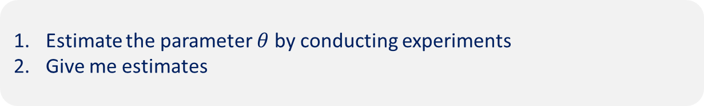
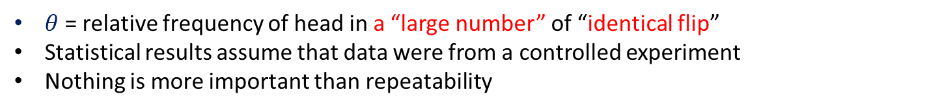
Frequentist vs Bayesian : Coin Tossing
Frequentist
$θ$= relative frequency of head in a “large number” of “identical flip”
Statistical results assume that data were from a controlled experiment
Nothing is more important than repeatability
Try
Estimate the parameter $θ$ by conducting experiments
Give me estimates

Slide 6

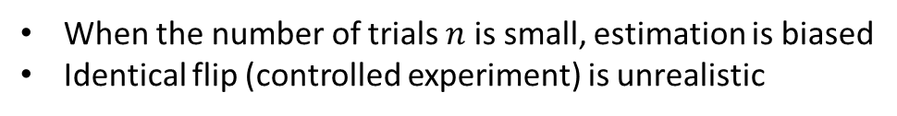
Frequentist vs Bayesian : Coin Tossing
Frequentist
$θ$= relative frequency of head in a “large number” of “identical flip”
Statistical results assume that data were from a controlled experiment
Nothing is more important than repeatability
Issues
When the number of trials $n$ is small, estimation is biased
Identical flip (controlled experiment) is unrealistic
$\frac{\text{\#}\text{Success}}{\text{\#}\text{Trials}}$: $\frac{\text{1}}{\text{3}}, \frac{\text{5}}{\text{6}}, \frac{\text{5}}{1\text{3}}\text{,} \frac{\text{129}}{\text{3}\text{13}}\text{,} \frac{\text{61423}}{\text{123400}}$

Slide 7
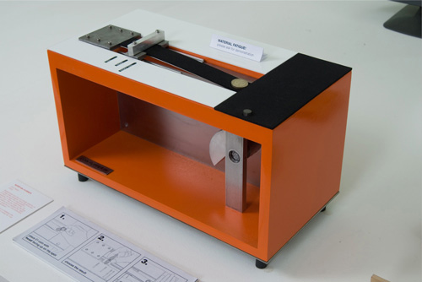
Identical Coin Tossing
The Artist might be a frequentist
http://www.dotmancando.info/index.php?/projects/coin-flipper/

Slide 8

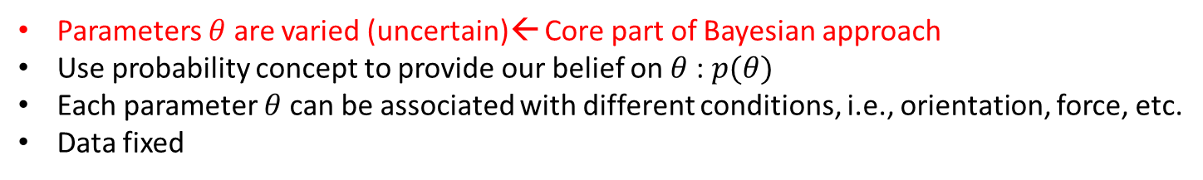
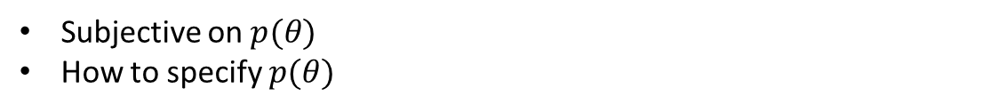
Frequentist vs Bayesian : Coin Tossing
Frequentist
$θ$= relative frequency of head in a “large number” of “identical flip”
Statistical results assume that data were from a controlled experiment
Nothing is more important than repeatability
Issues
When the number of trials $n$ is small, estimation is biased
Identical flip (controlled experiment) is unrealistic
$\frac{\text{\#}\text{Success}}{\text{\#}\text{Trials}}$: $\frac{\text{1}}{\text{3}}, \frac{\text{5}}{\text{6}}, \frac{\text{5}}{1\text{3}}\text{,} \frac{\text{129}}{\text{3}\text{13}}\text{,} \frac{\text{61423}}{\text{123400}}$
Bayesian
Parameters $θ$ are varied (uncertain)← Core part of Bayesian approach
Use probability concept to provide our belief on $θ$ : $p(θ)$
Each parameter $θ$can be associated with different conditions, i.e., orientation, force, etc.
Data fixed
Issues
Subjective on $p(θ)$
How to specify $p(θ)$

Slide 9
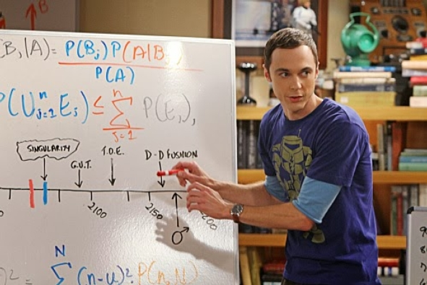
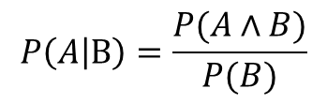
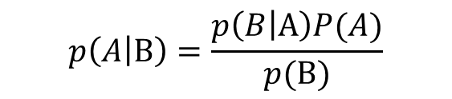
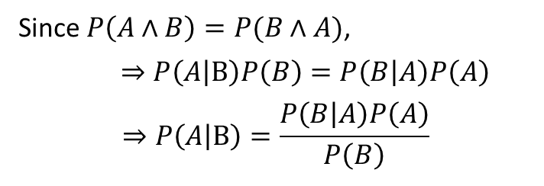
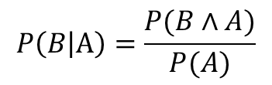
Bayes’ rule
$$p\left(A | B\right)=\frac{p\left(B | A\right)P(A)}{p(B)}$$
Bayes’ rule will play fundamental role
in proceeding Bayesian statistical analysis
Derivation of Bayes’ rule :
$$P\left(A | B\right)=\frac{P(A∧B)}{P(B)}$$
$$P\left(B | A\right)=\frac{P(B∧A)}{P(A)}$$
Since $P\left(A∧B\right)=P(B∧A)$,
$⇒$ $P\left(A | B\right)P\left(B\right)=P\left(B | A\right)P\left(A\right)$
$$⇒P\left(A | B\right)=\frac{P\left(B | A\right)P\left(A\right)}{P\left(B\right)}$$

Slide 10

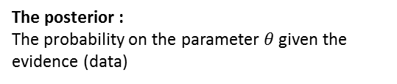

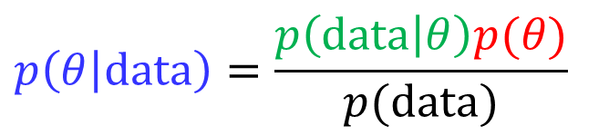


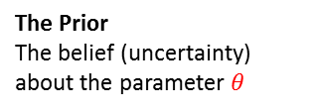
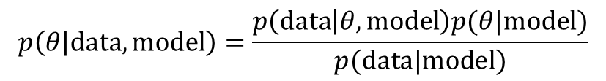
Bayes’ rule in Statistics
The posterior :
The probability on the parameter $θ$given the evidence (data)
The evidence
The probability of getting this evidence given the parameter
The Prior
The belief (uncertainty) about the parameter $θ$
$$p(θ)$$
$$p\left(θ | data\right)=\frac{p\left(data | θ\right)p(θ)}{p(data)}$$
$$θ$$
$$p(θ|data)$$
The Marginal probability
The probability of the evidence, Probability of data over all possibilities
$$θ$$
Parameter instantiates one model among a model class
$$p\left(θ | data,model\right)=\frac{p\left(data | θ,model\right)p(θ|model)}{p(data|model)}$$
Approaches
Select a model for data (structure)
Specify a prior on model parameters
Likelihood
Construct posterior
If necessary, predict unobserved value given the updated information on the parameters

Slide 11


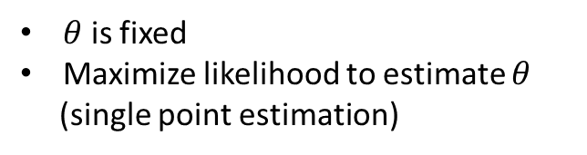




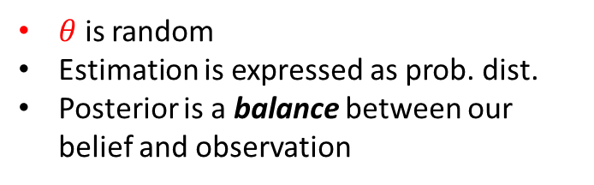
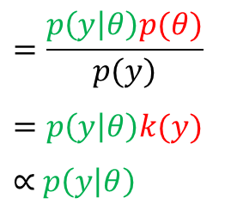
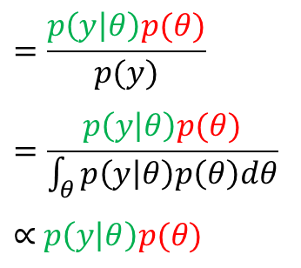
Estimating Model Parameters
Frequentist approach
Bayesian approach
$$=\frac{p\left(y | θ\right)p(θ)}{p(y)}$$
$$=p\left(y | θ\right)k(y)$$
$∝$ $p\left(y | θ\right)$
$$=\frac{p\left(y | θ\right)p(θ)}{p(y)}$$
$$=\frac{p\left(y | θ\right)p(θ)}{\int_{θ}^{ }{p\left(y | θ\right)p\left(θ\right)dθ}}$$
$∝$ $p\left(y | θ\right)p(θ)$
$$p\left(θ | y\right)$$
$$p\left(θ | y\right)$$
$$\left(k\left(y\right)=\frac{p(θ)}{p(y)}\right)$$
$$L\left(θ\right)=p\left(y | θ\right)$$
$θ$ is fixed
Maximize likelihood to estimate $θ$
(single point estimation)
$θ$ is random
Estimation is expressed as prob. dist.
Posterior is a balance between our belief and observation
$$θ^{∗}=arg\max_{θ}{L\left(θ\right)}$$
$$θ^{∗}=arg\max_{θ}{p\left(θ | y\right)}$$
Maximum Likelihood estimation (MLE)
Maximum a posteriori estimation (MAP)

Slide 12




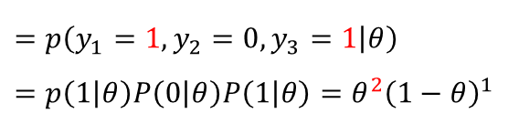


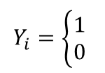


Maximum Likelihood Estimation for Coin Flipping Probability
$$Y_{i}=\left\{\begin{aligned}1 \\ 0 \end{aligned}\right.$$
Whole population
$$Y_{i}\sim B\left(θ\right)$$
$$if Head$$
$$if Tail$$
$$θ$$
$$p\left(y_{i}\right)=B\left(y_{i}|θ\right)=θ^{y_{i}}{\left(1−θ\right)}^{1−y_{i}}$$
sample
$θ∈[0,1]$ : Probability of having a head
?
$$y=(y_{1},y_{2},…,y_{n})$$
Likelihood of a single observation :
$L\left(θ\right)=P\left(y_{i} | θ\right)=θ^{y_{i}}{\left(1−θ\right)}^{1−y_{i}}$
Likelihood of a three-observations $y=\left(y_{1},y_{2},y_{3}\right)=(1,0,1)$:
$$L\left(θ\right)$$
$$=p\left(y_{1}=1, y_{2}=0, y_{3}=1 | θ\right)$$
$$=p\left(1 | θ\right)P\left(0 | θ\right)P\left(1 | θ\right)=θ^{2}{\left(1−θ\right)}^{1}$$
i.i.d.→ Exchangeability
Likelihood of $n−$observations :
$L\left(θ\right)=P\left(y_{1}, y_{2}, …, y_{n} | θ\right)=θ^{Σy_{i}}{\left(1−θ\right)}^{n−Σy_{i}}$
$Σ_{1}^{n}y_{i}$ : Number of Heads in $n$ trials (sufficient statistics)

Slide 13
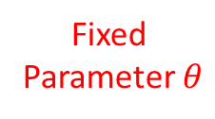
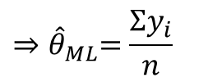

Maximum Likelihood Estimation for Coin Flipping Probability
Population
sample
Fixed
Parameter $θ$
$${\hat{θ}}_{ML}$$
Maximum likelihood estimation :
$${\hat{θ}}_{ML}=\underset{θ}{argmax}{L\left(θ\right)=p\left(y_{1}, y_{2}, …, y_{n} | θ\right)=θ^{Σy_{i}}{\left(1−θ\right)}^{n−Σy_{i}}}$$
$$\frac{∂L\left(θ\right)}{∂θ}=Σy_{i}θ^{Σy_{i}−1}{\left(1−θ\right)}^{n−Σy_{i}}−θ^{Σy_{i}}\left(n−Σy_{i}\right){\left(1−θ\right)}^{n−Σy_{i}−1}=0$$
$${⇒\hat{θ}}_{ML}=\frac{Σy_{i}}{n}$$
MLE estimation gives a relative frequency

Slide 14


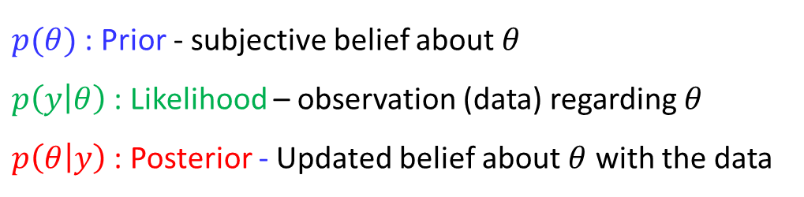
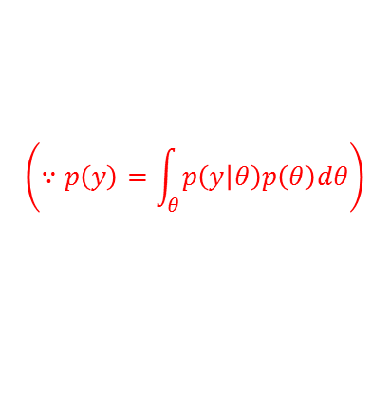
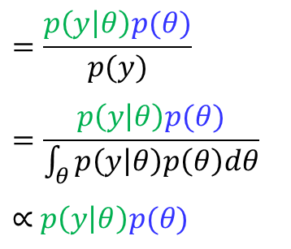
Bayesian Approach for Estimating Model Parameters
The essential characteristics of Bayesian methods
= explicit use of probability for quantifying uncertainty in the statistical models
Bayes’ rule:
$$=\frac{p\left(y | θ\right)p(θ)}{p(y)}$$
$$=\frac{p\left(y | θ\right)p(θ)}{\int_{θ}^{ }{p\left(y | θ\right)p\left(θ\right)dθ}}$$
$∝$ $p\left(y | θ\right)p(θ)$
$$p\left(θ | y\right)$$
$$\left(∵p\left(y\right)=\int_{θ}^{ }{p\left(y | θ\right)p\left(θ\right)dθ}\right)$$
Posterior $∝$ Likelihood X Prior
$p(θ)$ : Prior - subjective belief about $θ$
$p\left(y | θ\right)$ : Likelihood – observation (data) regarding $θ$
$p\left(θ | y\right)$ : Posterior - Updated belief about $θ$ with the data

Slide 15

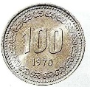

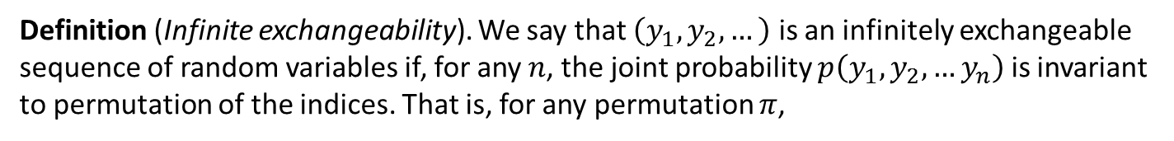
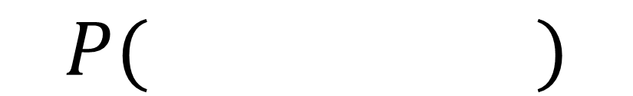
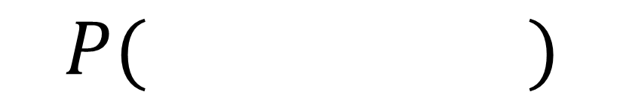



Exchangeability
=
$$P( )$$
$$P( )$$
Definition (Infinite exchangeability). We say that $\left(y_{1}, y_{2},…\right)$ is an infinitely exchangeable sequence of random variables if, for any $n$, the joint probability $p\left(y_{1}, y_{2},…y_{n}\right)$ is invariant to permutation of the indices. That is, for any permutation $π$,
$$p_{Y}\left(y_{1}, y_{2},…y_{n}\right)=p_{Y}\left(y_{π_{1}}, y_{π_{2}},…, y_{π_{n}}\right)$$
I
R.V.s are independent and identically distributed (i.i.d)
E
Random variables are infinitely exchangeability
I
E
$$P\left(R,R,B,B,B\right)=P\left(B,R,B,B,R\right)$$
Check!!
Exchangeable
$$P\left(t_{2}=R|t_{1}=R\right)≠P\left(t_{2}=R|t_{1}=B\right)$$
Not independent

Slide 16



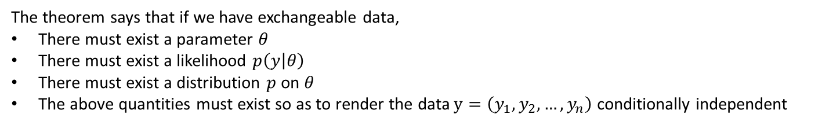
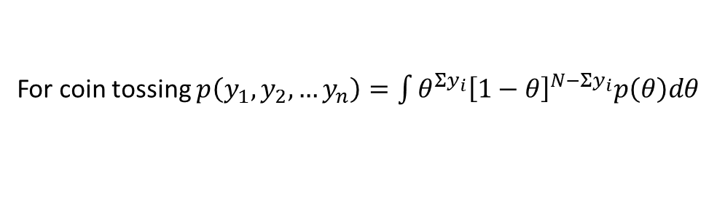
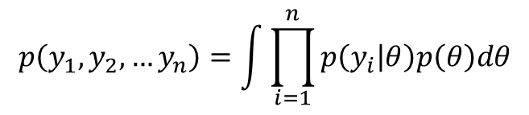

Exchangeability
$$θ$$
$$y_{1}$$
$$y_{2}$$
$$y_{n}$$
Theorem (De Finetti, 1930s). A sequence of random variables $\left(y_{1}, y_{2},…\right)$ is infinitely exchangeable iff, for all $n$,
$$p\left(y_{1}, y_{2},…y_{n}\right)=\int{\prod_{i=1}^{n}{p\left(y_{i} | θ\right)p\left(θ\right)dθ}}$$
For coin tossing $p\left(y_{1}, y_{2},…y_{n}\right)=\int{θ^{Σy_{i}}{\left[1−θ\right]}^{N−Σy_{i}}p\left(θ\right)dθ}$
The theorem says that if we have exchangeable data,
There must exist a parameter $θ$
There must exist a likelihood $p\left(y | θ\right)$
There must exist a distribution $p$ on $θ$
The above quantities must exist so as to render the data $y=\left(y_{1},y_{2},…, y_{n}\right)$ conditionally independent
Prior (Bayesian approach) is suggested by the data being exchangeable

Slide 17







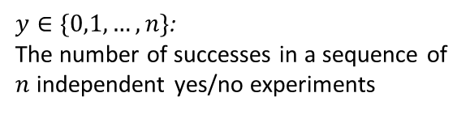


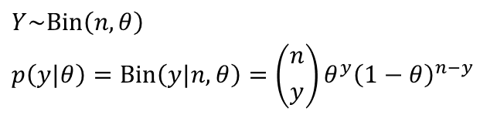

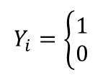
Maximum a posteriori estimation (Bayesian Estimation) for Coin Flipping Probability
Whole population
$$Y_{i}\sim B\left(θ\right)$$
$$Y_{i}=\left\{\begin{aligned}1 \\ 0 \end{aligned}\right.$$
$$if Head$$
$$if Tail$$
$$θ$$
$$p\left(y_{i}\right)=B\left(y_{i}|θ\right)=θ^{y_{i}}{\left(1−θ\right)}^{1−y_{i}}$$
sample
$θ∈[0,1]$ : Probability of having a head
?
$$y=(y_{1},y_{2},…,y_{n})$$
$n$ times
Bernoulli distribution
Binomial distribution
$$Y_{i}\sim B\left(θ\right)$$
$$Y_{i}=\left\{\begin{aligned}1 \\ 0 \end{aligned}\right.$$
$$if Head$$
$$Y\sim Bin\left(n,θ\right)$$
$$p\left(y|θ\right)=Bin\left(y|n,θ\right)=\left({n \atop y}\right)θ^{y}{\left(1−θ\right)}^{n−y}$$
$$if Tail$$
$$p\left(y_{i}\right)=B\left(y_{i}|θ\right)=θ^{y_{i}}{\left(1−θ\right)}^{1−y_{i}}$$
$θ∈[0,1]$ : Probability of having a head
$y∈\{0,1,…,n\}$:
The number of successes in a sequence of
$n$ independent yes/no experiments

Slide 18
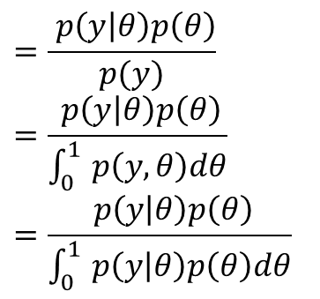
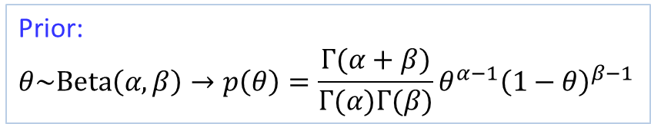

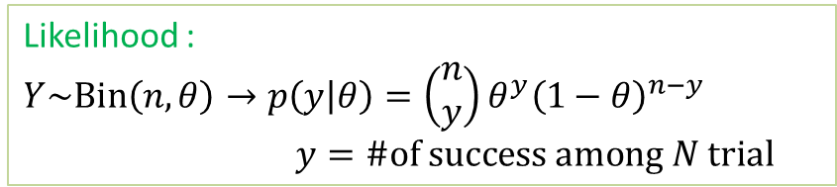
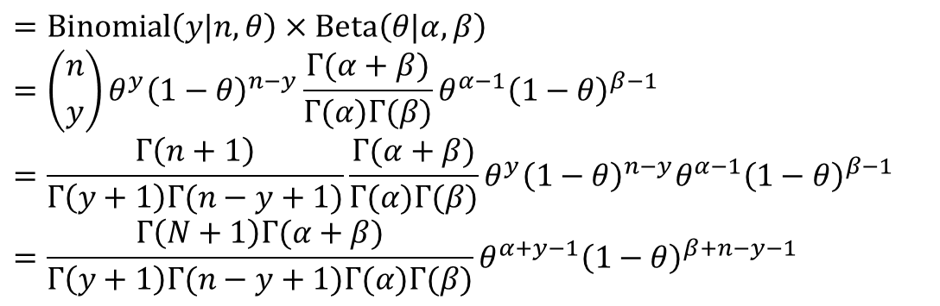
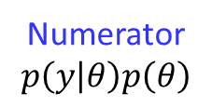
Maximum a posteriori estimation (Bayesian Estimation) for Coin Flipping Probability
$$=\frac{ p\left(y | θ\right)p\left(θ\right)}{p(y)}$$
$$=\frac{ p\left(y | θ\right)p\left(θ\right)}{\int_{0}^{1 }{p\left(y,θ\right)dθ}}$$
$$=\frac{ p\left(y | θ\right)p\left(θ\right)}{\int_{0}^{1 }{p\left(y | θ\right)p\left(θ\right)dθ}}$$
Likelihood :
$Y\sim Bin\left(n,θ\right)→p\left(y | θ\right)=\left(\begin{aligned}n \\ y\end{aligned}\right)θ^{y}{\left(1−θ\right)}^{n−y}$
$y=\#of success among N trial$
$$p\left(θ | y\right)$$
Prior:
$$θ\sim Beta\left(α,β\right)→p\left(θ\right)=\frac{Γ(α+β)}{Γ(α)Γ(β)}θ^{α−1}{\left(1−θ\right)}^{β−1}$$
Numerator
$$p\left(y | θ\right)p\left(θ\right)$$
$$=Binomial\left(y|n,θ\right)×Beta\left(θ|α,β\right)$$
$$=\left({n \atop y}\right)θ^{y}{\left(1−θ\right)}^{n−y}\frac{Γ(α+β)}{Γ(α)Γ(β)}θ^{α−1}{\left(1−θ\right)}^{β−1}$$
$$=\frac{Γ\left(n+1\right)}{Γ\left(y+1\right)Γ(n−y+1)}{\frac{Γ(α+β)}{Γ(α)Γ(β)}θ}^{y}{\left(1−θ\right)}^{n−y}θ^{α−1}{\left(1−θ\right)}^{β−1}$$
$$=\frac{Γ\left(N+1\right)Γ(α+β)}{Γ\left(y+1\right)Γ(n−y+1)Γ(α)Γ(β)}θ^{α+y−1}{\left(1−θ\right)}^{β+n−y−1}$$

Slide 19
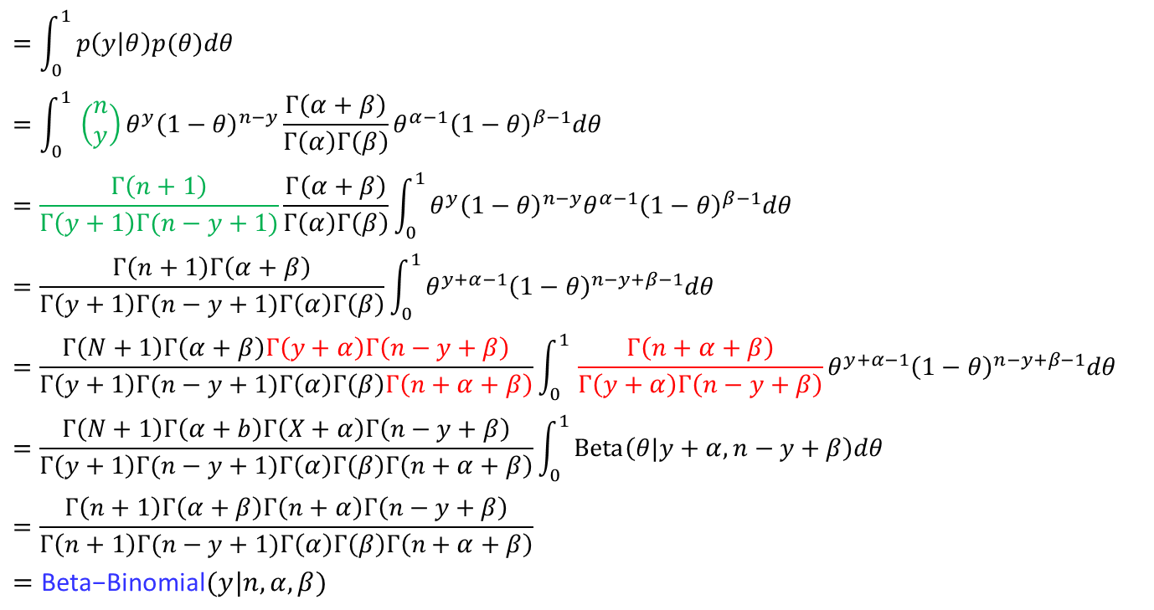


Maximum a posteriori estimation (Bayesian Estimation) for Coin Flipping Probability
denominator
$$=\int_{0}^{1 }{p\left(y | θ\right)p(θ)dθ}$$
$$=\int_{0}^{1 }{\left(\begin{aligned}n \\ y\end{aligned}\right)θ^{y}{\left(1−θ\right)}^{n−y}\frac{Γ\left(α+β\right)}{Γ\left(α\right)Γ\left(β\right)}θ^{α−1}{\left(1−θ\right)}^{β−1}dθ}$$
$$=\frac{Γ\left(n+1\right)}{Γ\left(y+1\right)Γ(n−y+1)}\frac{Γ\left(α+β\right)}{Γ\left(α\right)Γ\left(β\right)}\int_{0}^{1 }{θ^{y}{\left(1−θ\right)}^{n−y}θ^{α−1}{\left(1−θ\right)}^{β−1}dθ}$$
$$=\frac{Γ\left(n+1\right)Γ\left(α+β\right)}{Γ\left(y+1\right)Γ(n−y+1)Γ\left(α\right)Γ\left(β\right)}\int_{0}^{1 }{θ^{y+α−1}{\left(1−θ\right)}^{n−y+β−1}dθ}$$
$$=\frac{Γ\left(N+1\right)Γ\left(α+β\right)Γ\left(y+α\right)Γ\left(n−y+β\right)}{Γ\left(y+1\right)Γ(n−y+1)Γ\left(α\right)Γ\left(β\right)Γ\left(n+α+β\right)}\int_{0}^{1 }{\frac{Γ\left(n+α+β\right)}{Γ\left(y+α\right)Γ\left(n−y+β\right)}θ^{y+α−1}{\left(1−θ\right)}^{n−y+β−1}dθ}$$
$$=\frac{Γ\left(N+1\right)Γ\left(α+b\right)Γ\left(X+α\right)Γ\left(n−y+β\right)}{Γ\left(y+1\right)Γ(n−y+1)Γ\left(α\right)Γ\left(β\right)Γ\left(n+α+β\right)}\int_{0}^{1 }{Beta\left(θ|y+α, n−y+β\right)dθ}$$
$$=\frac{Γ\left(n+1\right)Γ\left(α+β\right)Γ\left(n+α\right)Γ\left(n−y+β\right)}{Γ\left(n+1\right)Γ(n−y+1)Γ\left(α\right)Γ\left(β\right)Γ\left(n+α+β\right)}$$
$$=\text{Beta}\text{−}\text{Binomial}(y|n,α,β)$$
$$p\left(y\right)$$
$$\left(\begin{aligned}n \\ y\end{aligned}\right)=\frac{n!}{y!\left(n−y\right)!}=\frac{Γ\left(n+1\right)}{Γ\left(y+1\right)Γ(n−y+1)}$$

Slide 20
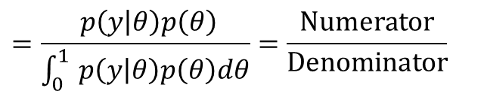

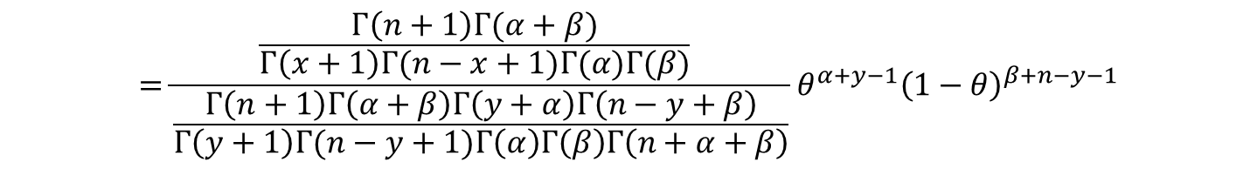
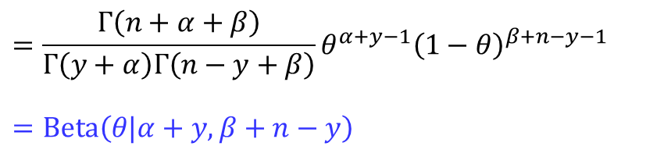
Maximum a posteriori estimation (Bayesian Estimation) for Coin Flipping Probability
$$=\frac{ p\left(y | θ\right)p\left(θ\right)}{\int_{0}^{1 }{p\left(y | θ\right)p\left(θ\right)dθ}}=\frac{Numerator}{Denominator}$$
$$p\left(θ | y\right)$$
$$=\frac{\frac{Γ\left(n+1\right)Γ(α+β)}{Γ\left(x+1\right)Γ(n−x+1)Γ(α)Γ(β)} }{\frac{Γ\left(n+1\right)Γ\left(α+β\right)Γ\left(y+α\right)Γ\left(n−y+β\right)}{Γ\left(y+1\right)Γ(n−y+1)Γ\left(α\right)Γ\left(β\right)Γ\left(n+α+β\right)}}θ^{α+y−1}{\left(1−θ\right)}^{β+n−y−1}$$
$$=\frac{Γ\left(n+α+β\right)}{Γ\left(y+α\right)Γ\left(n−y+β\right)}θ^{α+y−1}{\left(1−θ\right)}^{β+n−y−1}$$
$$=Beta\left(θ|α+y,β+n−y\right)$$
data
$$p\left(θ\right)=Beta\left(θ|α,β\right) p\left(θ | y\right)=Beta\left(θ|α+y,β+n−y\right)$$

Slide 21





Maximum a posteriori estimation (Bayesian Estimation) for Coin Flipping Probability
$$Beta\left(θ|α,β\right)$$
$$Beta\left(θ|α=1,β=1\right)$$
$$Beta\left(θ|α=1+26,β=1+24\right)$$
$$Beta\left(θ|α=1+259,β=1+241\right)$$

Slide 22
Maximum a posteriori estimation (Bayesian Estimation) for Coin Flipping Probability
Jupyter Demo Simulation

Slide 23










Confidence Interval vs. Credible region
Frequentist approach
Bayesian approach
Describe variability in data given the fixed parameter $θ$
Describe variability in $θ$ for fixed data
True parameter $θ$
Observed data
Variability in data
Variability in $θ$
$$CI_{θ}$$
$$CR_{θ}$$
“There is a 95% probability that when I compute $CI_{θ}$ from a current data, the computed CI contain $θ_{true}$
"Given our observed data, there is a 95% probability that the true value of $θ$falls within Credible region $CR_{θ}$”
From current data set,
We can only say that $θ∈CI$ or $θ∉CI$
Form current data set,
We can make Probabilistic statement $\operatorname{Pr}\left(θ∈CR\right)=0.95$

Slide 24






Confidence Interval vs. Credible region
Frequentist approach
Bayesian approach
Describe variability in data given the fixed parameter $θ$
Describe variability in $θ$ for fixed data
$θ∈CI$ or $θ∉CI$
$$\operatorname{Pr}\left(θ∈CR\right)=0.95$$
If the experiment were repeated an infinite number of times, 95% of the calculated intervals would contain $θ$ .
There is a 95% chance $θ$ is in CR

Slide 25




Maximum a posteriori estimation (Bayesian Estimation) for Coin Flipping Probability
From the previous result $p\left(θ | y\right)=Beta\left(θ|a+y,b+n−y\right),$
$$𝔼\left(θ\right)=\frac{α}{α+β}$$
$$=\frac{α+y}{α+β+n}=\frac{α}{α+β}\frac{α+β}{(α+β+n)}+\frac{y}{n}\frac{n}{(α+β+n)}$$
$$=𝔼\left(θ\right)\frac{α+β}{α+β+n}+{\hat{θ}}_{ML}\frac{n}{α+β+n}$$
$$𝔼\left(θ|y\right)$$
As $n→∞,𝔼\left(θ|X\right)→\frac{y}{n}{=\hat{θ}}_{ML}$
Large value of $α+β$ signifies Posterior
→In the limit, the prior does not influence the results. That is, the results are dominated by the data (observation).
$$var\left(θ | y\right)=\frac{\left(α+y\right)(β+n−y)}{{\left(α+β+n\right)}^{2}(α+β+n+1)}=\frac{E\left(θ | y\right)\left(1−E\left(θ | y\right)\right)}{α+β+n+1}$$
As $n and \left(n−y\right)→∞, var\left(θ | y\right)→\frac{1}{n}\frac{y}{n}\left(1−\frac{y}{n}\right)=\frac{p\left(1−p\right)}{n}$

Slide 26




Posterior as compromise between data and prior information
$E\left(u\right)=E\left(E\left(u|v\right)\right)$
$E\left(θ\right)=E\left(E\left(θ|y\right)\right)$
The prior mean of $θ$ is the average of all possible posterior means over the distribution of possible data
$var\left(u\right)=E\left(var\left(u|v\right)\right)+var\left(E\left(u|v\right)\right)$
$$var\left(θ\right)=E\left(var\left(θ|y\right)\right)+var\left(E\left(θ|y\right)\right)$$
The posterior variance is on average smaller than the prior variance by an amount that depends on the variation in posterior means over the distribution of all the possible data
The posterior distribution is centered at a point that represents a compromise between the prior information and the data, and the compromise is controlled to a greater extent by the data as the sample size increases

Slide 27



The Role of Prior
Example (BDA Ch.2.4)
Probability of girl birth given placenta Previa
Among 980 births with placenta Previa, 437 are females
How much evidence does this provide for the claim that the proportion of female birth in the population of placenta Previa birth is less than 0.485?
$$P\left(θ\right)=Beta(θ|α, β)$$
$$P\left(θ|y\right)=Beta\left(θ | α+437,β+543\right)$$
$$𝔼\left(θ\right)=\frac{α+437}{α+437+β+543}$$

Slide 28


Beyond Parameter Estimation: Prediction based on Bayesian Approach
Posterior distribution
the distribution of the unknown and an observable parameter $θ$ given observed $y$
$p\left(θ | y\right)=\frac{p\left(y | θ\right)p(θ)}{p(y)}=\frac{p\left(y | θ\right)p(θ)}{\int_{θ}^{ }{p\left(y | θ\right)p\left(θ\right)dθ}}∝$ $p\left(y | θ\right)p(θ)$
Prior predictive distribution
Before the data $y$ are considered, the distribution of the unknown but observable $y$ is
$$p\left(y\right)=\int_{θ}^{ }{p\left(y,θ\right)dθ=}\int_{θ}^{ }{p\left(y | θ\right)p(θ) }$$
Posterior predictive distribution
Prediction for an observable $\hat{y}$ conditional on the observed $y$
$$p\left(\hat{y}|y\right)=\int_{θ}^{ }{p\left(\hat{y},θ|y\right)dθ=}\int_{θ}^{ }{p\left(\hat{y} | θ,y\right)p(θ|y)dθ}=\int_{θ}^{ }{p\left(\hat{y} | θ\right)p(θ|y)dθ}$$
Posterior predictive distribution=an average of conditional predictions over the posterior dist. on $θ$

Slide 29








Prior predictive distribution: Coin tossing example
Prior predictive distribution
Before the data $y$ are considered, the distribution of the unknown but observablen$y$is
$$y=Σ_{i=1}^{n}y_{i}$$
:the number of persons with dieses among $n$
Population
sample
$$=\int_{0}^{1 }{P\left(y,θ\right)dθ}$$
$$=\int_{0}^{1 }{P\left(y | θ\right)p(θ)dθ}$$
$$=\int_{0}^{1 }{\left(\begin{aligned}n \\ y\end{aligned}\right)θ^{y}{\left(1−θ\right)}^{n−y}\frac{Γ\left(α+β\right)}{Γ\left(α\right)Γ\left(β\right)}θ^{α−1}{\left(1−θ\right)}^{β−1}dθ}$$
$$=\frac{Γ\left(n+1\right)}{Γ\left(y+1\right)Γ(n−y+1)}\frac{Γ\left(α+β\right)}{Γ\left(α\right)Γ\left(β\right)}\int_{0}^{1 }{θ^{y}{\left(1−θ\right)}^{n−y}θ^{α−1}{\left(1−θ\right)}^{b−1}dθ}$$
$$=\frac{Γ\left(n+1\right)Γ\left(α+β\right)}{Γ\left(y+1\right)Γ(n−y+1)Γ\left(α\right)Γ\left(β\right)}\int_{0}^{1 }{θ^{y+α−1}{\left(1−θ\right)}^{n−y+β−1}dθ}$$
$$=\frac{Γ\left(n+1\right)Γ\left(α+β\right)Γ\left(y+α\right)Γ\left(n−y+β\right)}{Γ\left(y+1\right)Γ(n−y+1)Γ\left(α\right)Γ\left(β\right)Γ\left(n+α+β\right)}\int_{0}^{1 }{\frac{Γ\left(n+α+β\right)}{Γ\left(y+α\right)Γ\left(n−y+β\right)}θ^{y+α−1}{\left(1−θ\right)}^{n−y+β−1}dθ}$$
$$=\frac{Γ\left(n+1\right)Γ\left(α+β\right)Γ\left(y+α\right)Γ\left(n−y+β\right)}{Γ\left(y+1\right)Γ(n−y+1)Γ\left(α\right)Γ\left(β\right)Γ\left(n+α+β\right)}\int_{0}^{1 }{Beta\left(θ|y+α, n−y+β\right)dθ}$$
$$=\frac{Γ\left(n+1\right)Γ\left(α+β\right)Γ\left(y+α\right)Γ\left(n−y+β\right)}{Γ\left(y+1\right)Γ(n−y+1)Γ\left(α\right)Γ\left(β\right)Γ\left(y+α+β\right)}1$$
$$=\text{Beta}\text{−}\text{Binomial}(y|n,α,β)$$
$$P\left(y\right)$$
Fraction of disease
$$θ$$
$P\left(y | θ\right)=Bin\left(y | n,θ\right)$,
$$p\left(θ\right)=Beta(α,β)$$
$$\left(\begin{aligned}n \\ y\end{aligned}\right)=\frac{y!}{y!\left(n−y\right)!}=\frac{Γ\left(n+1\right)}{Γ\left(y+1\right)Γ(n−y+1)}$$
For$α=1$, $β=1$, $P\left(y\right)=\frac{1}{n+1}$ (check!)

Slide 30







Posterior-Predictive Distribution : Coin tossing example
sample
$$\hat{n}$$
Population
sample
$$n$$
$$\hat{y}$$
$$Y$$
Probability of
having disease
$$θ$$
$$y=Σ_{i=1}^{n}y_{i}$$
the number of persons with dieses among $n$
Posterior predictive distribution
Prediction for an observable $\hat{y}$ conditional on the observed $y$
$$p\left(\hat{y}|y\right)=\int_{θ}^{ }{p\left(\hat{y},θ|y\right)dθ=}\int_{θ}^{ }{p\left(\hat{y} | θ,y\right)p(θ|y)dθ}=\int_{θ}^{ }{p\left(\hat{y} | θ\right)p(θ|y)dθ}$$
Posterior predictive distribution=an average of conditional predictions over the posterior dist. on $θ$

Slide 31










Posterior-Predictive Distribution : Coin tossing example
Remember Prior Predictive distribution
$$p\left(y\right)=\int_{0}^{1 }{p\left(y,θ\right)dθ}=\int_{0}^{1 }{p\left(y | θ\right)p(θ)dθ}$$
$=\text{Beta}\text{−}\text{Binomial}(y|n,α, β)$
$$p\left(θ\right)=Beta(a, b)$$
Using this result, the posterior predictive distribution is
$$p\left(\hat{y}|y\right)=\int_{0}^{1 }{p\left(\hat{y},θ|y\right)dθ}=\int_{0}^{1 }{p\left(\hat{y} | θ\right)p(θ|y)dθ}$$
$$=\text{Beta}\text{−}\text{Binomial}(\hat{Y}|N,α+y,β+n−y)$$
$$p\left(θ | y\right)=Beta(α+y, β+n−y)$$
$$=\int_{0}^{1 }{θp\left(θ | y\right)dθ}$$
$$=𝔼\left[θ|y\right]$$
$$=\frac{α+y}{α+y+β+n−y}$$
$$=\frac{α+y}{α+β+n}$$
When $\hat{y}=1$,
$$p\left(\hat{y}=1|y\right)$$
$$∵p\left(\hat{y}=1 | θ\right)=θ$$
← When $N$ is small prior has strong influence
For $α=1$, $β=1$, $P\left(\hat{y}|y\right)=\frac{y+1}{n+2}$ (check!)

Slide 32
Beyond Parameter Estimation: Prediction based on Bayesian Approach
Jupyter Demo Simulation

Slide 33
Three Steps in Bayesian Approaches
Step 1: Modeling
setting up a full probability model, a joint probability distribution for all observable and unobservable quantities in a target problem
Step 2: Inferencing
calculate and interpret the appropriate posterior distribution, the conditional probability distribution of the unobserved quantities of interests
Step 3: Checking
Evaluate the fit of the model and the sensitiveness of the assumption in step 1

Slide 34
Supplements

Slide 35












Bayesian Approach Example : Is sea water contaminated with cholera
Prior
$$θ=\left\{\begin{aligned} 0 Sea without \text{cholera} \\ 1 Sea with \text{cholera} \end{aligned}\right.$$
$$p(θ)=\left\{\begin{aligned}1/2 \\ 1/2\end{aligned}\right.$$
$$θ=0$$
Uniform prior
Discretized $θ$
Whole population
$$θ=1$$
$$θ$$
Likelihood
$$y_{i}=\left\{\begin{aligned}1 fish with \text{cholera} \\ 0 fish without \text{cholera}\end{aligned}\right.$$
sample
?
$$y=(y_{1},y_{2},y_{3})$$
$p(y_{i}=1|θ=0)=0⟶$ $p(y_{i}=0|θ=0)=1$
$p(y_{i}=1|θ=1)=\frac{1}{2}⟶$ $p(y_{i}0|θ=1)=\frac{1}{2}$
data $y=\{y_{1}=0,y_{2}=0, y_{3}=0\}$
Uninfected
$y_{i}$ are i.i.d.
$$P\left(y | θ=0\right)={\left(P(y=0|θ=0)\right)}^{3}={\left(1\right)}^{3}=1$$
$$P\left(y | θ=1\right)={\left(P(y=0|θ=1)\right)}^{3}={\left(1/2\right)}^{3}=1/8$$
Denominator (Marginal likelihood)
$$P(y)=\sum_{θ}^{ }{P\left(y | θ\right)P(θ)}$$
$$=P\left(y | θ=0\right)P\left(θ=0\right)+P\left(y | θ=1 \right)P(θ=1)=1×\frac{1}{2}+\frac{1}{8}×\frac{1}{2}=\frac{9}{16}$$

Slide 36



















Bayesian Approach Example : Is sea water contaminated with cholera
$$p\left(θ | y\right)=\frac{p\left(y | θ\right)p(θ)}{p(y)}$$
Posterior distribution:
$$P\left(θ=0 | y\right)=\frac{P\left(y | θ=0,\right)P\left(θ=0\right)}{P\left(y\right)}=\frac{1×1/2}{9/16 }=\frac{8}{9}$$
$$P\left(θ=1 | y\right)=\frac{P\left(y | θ=1,\right)P\left(θ=1\right)}{P\left(y\right)}=\frac{1/8×1/2}{9/16 }=\frac{1}{9}$$
Prior
$$P\left(θ=1\right)=\frac{1}{2}$$
Update with data
$$P\left(θ=0 | y\right)∝P\left(y | θ=0,\right)P\left(θ=0\right)=1×1/2$$
$$P\left(θ=1 | y\right)∝P\left(y | θ=1,\right)P\left(θ=1\right)=1/8×1/2$$
$$P\left(θ\right)$$
$$1/2$$
$$1/2$$
Bayes’ factor = $\frac{P\left(θ=0 | y\right)}{P\left(θ=1 | y\right)}=\frac{8}{1}$
$$θ$$
$$P\left(y|θ\right)$$
$$θ=0$$
$$θ=1$$
$$1$$
$$1/8$$
$$θ$$
$$P\left(θ|y\right)$$
$$1/2$$
$$1/16$$
$$θ$$

